Slide 2
Web Design with HTML and CSS
Introduction

Slide 3
Hypertext Markup Language

Slide 4
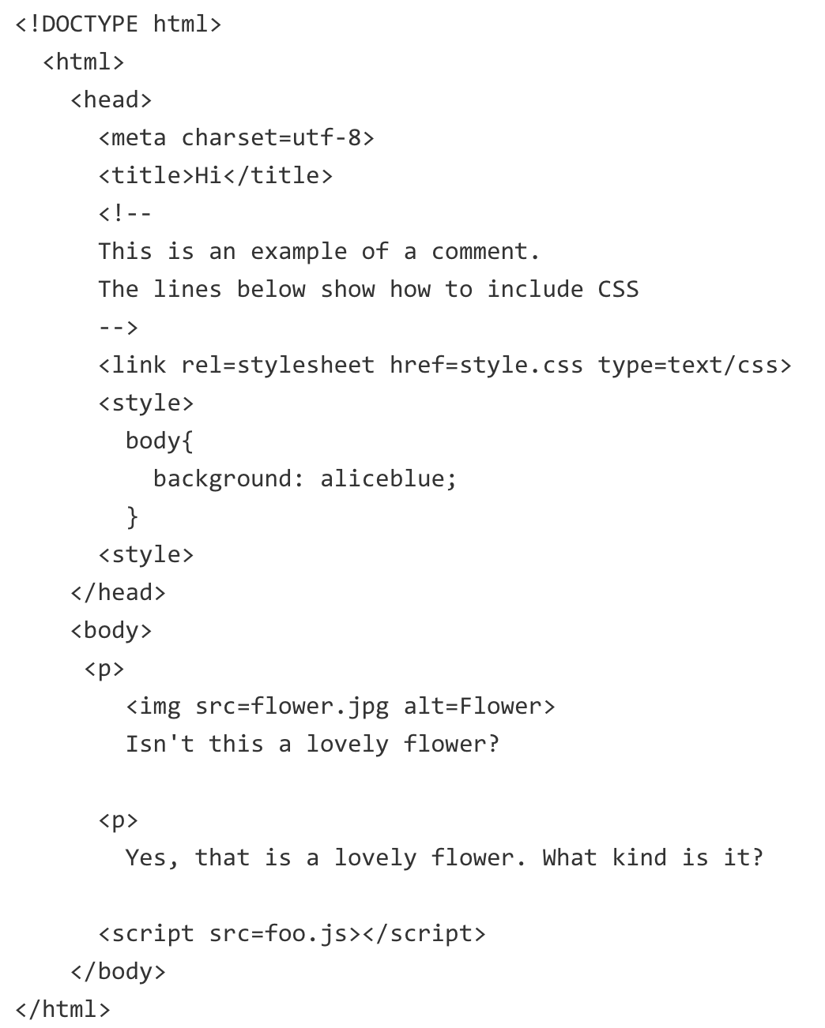
HTML

Slide 5
HTML
HTML stands for Hypertext Markup Language
Version: HTML 2.0, HTML 3.2, HTML 4.0, HTML 4.01, HTML 5
XHTML - a reformulation of HTML in XML: XHTML 1.0, XHTML 1.1 (XHTML 5.0 ?)

Slide 6
Required Tags
DOCTYPE: tells the browser which set of standards your page adheres to
<html>: frames the entire HTML page
<head>: frames the identification information of the page
title, style, base, link, meta, script, noscript
<body>: frames the content of the page

Slide 7
DOCTYPE Declarations
HTML 4.01 Strict: All HTML elements and attributes, but does not include presentational or deprecated elements
HTML 4.01 Transitional: All but include presentational or deprecated elements
HTML 4.01 Frameset: a variant of HTML 4 Transitional for documents that use frames.
HTML 5
<!DOCTYPE html>
Notes:
https://24ways.org/2005/transitional-vs-strict-markup

Slide 8
XHTML Rules
All elements must have a start tag
Elements with a start tag must have an end tag
Any element may be “self-closed” using />
Tags and attributes are case sensitive, typically lowercase
Attribute values must be enclosed in quotes
Empty attributes are forbidden
Special characters must be escaped using character entities.
Notes:
http://www.w3.org/MarkUp/2004/xhtml-faq#need

Slide 9
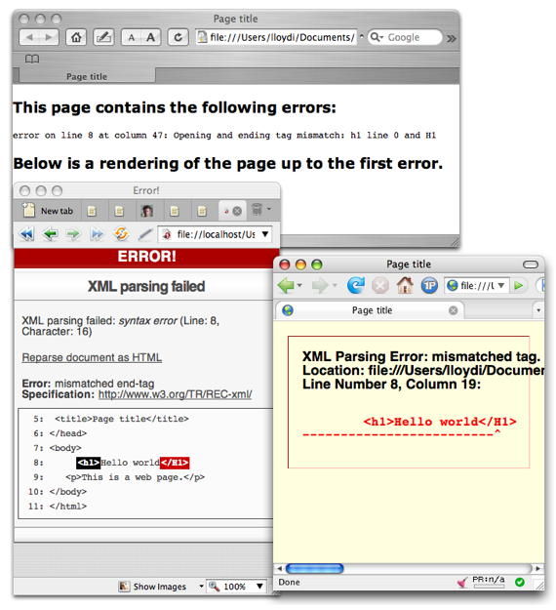
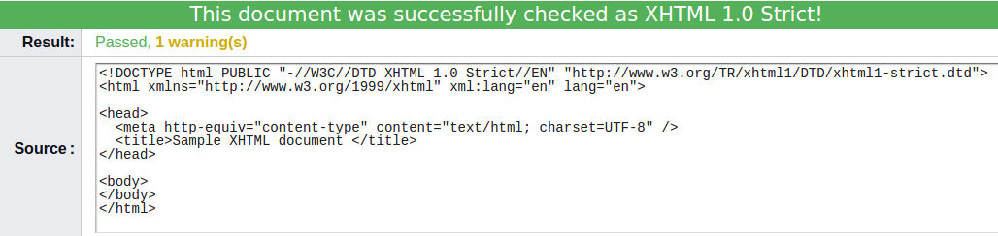
Simple XHTML document
Notes:
http://www.webstandards.org/learn/articles/askw3c/oct2003/

Slide 10
HTML 5
New semantic elements: <nav>, <section>, <article>, <header>, <footer>...
Enhancing accessibility using ARIA roles
<input type="text" aria-label="Tag" role="combobox"
aria-autocomplete="list" aria-owns="owned_listbox">
<ul role="listbox" id="owned_listbox">
<li role="option">Zebra</li>
<li role="option">Zoom</li>
</ul>
New form input types: time, color, url, month, date, week, datetime-local, email, tel...

Slide 11
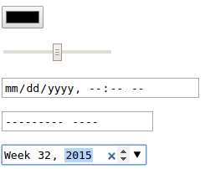
HTML 5 (cont.)
Examples:

Slide 12
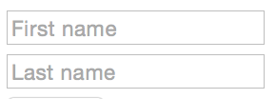
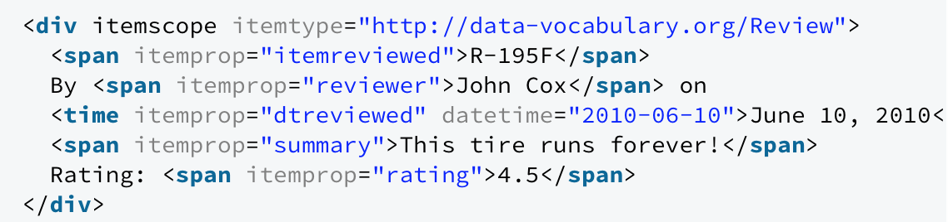
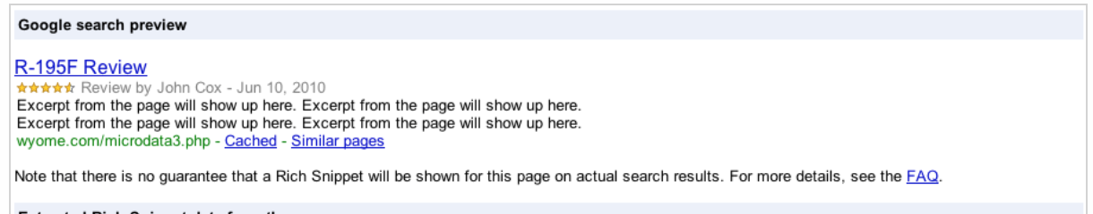
HTML 5 (cont.)
New attributes: autocomplete, multiple, autofocus, pattern, placeholder, list, max, min, required
Add semantic information to a web page
Using microdata attributes: improve how your page looks in search result

Slide 13
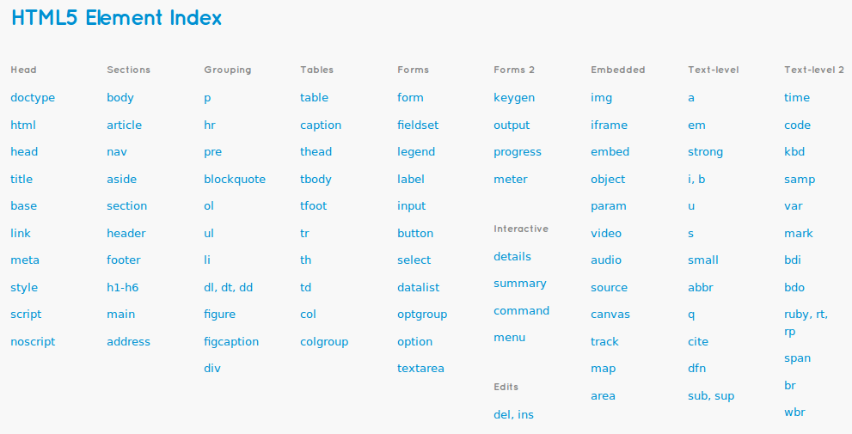
HTML 5 (cont.)

Slide 14
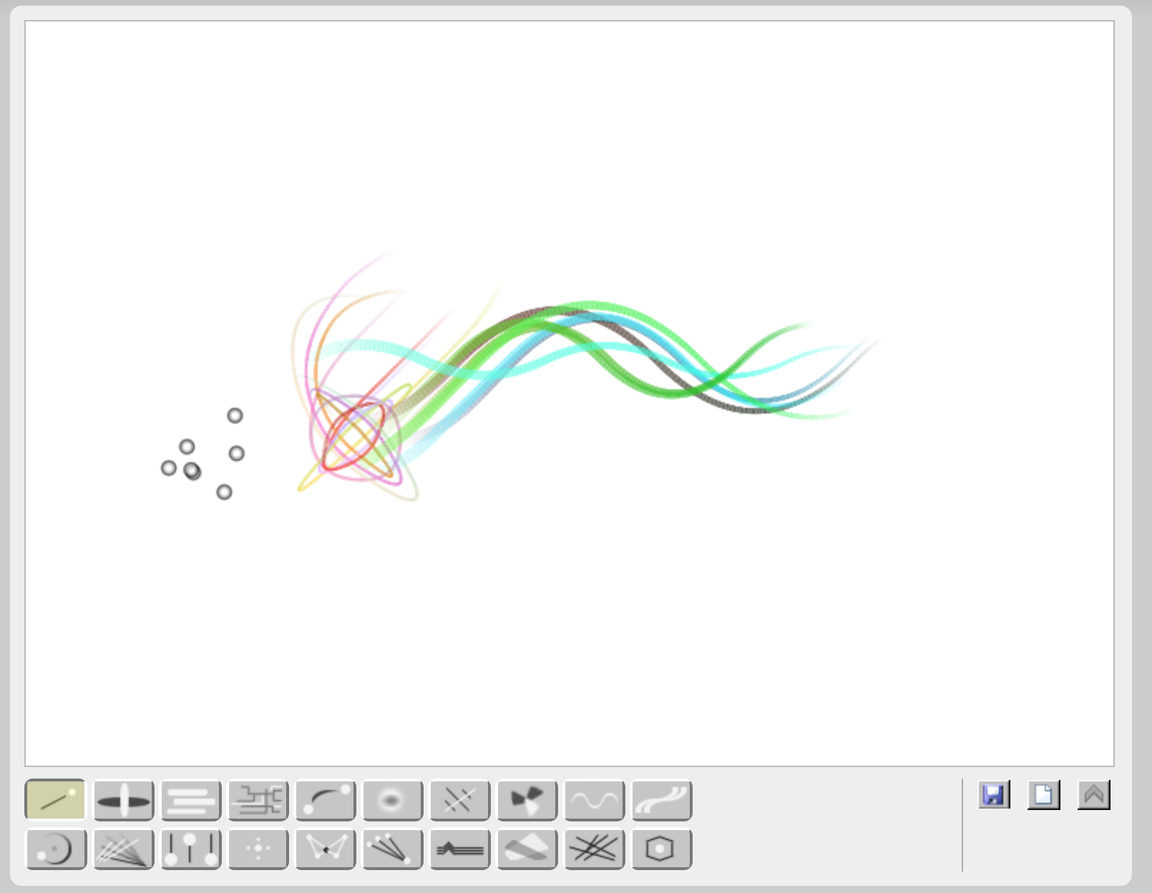
New DOM APIs
DOM: The Document Object Model is a platform- and language-neutral interface that will allow programs and scripts to dynamically access and update the content, structure and style of documents
Canvas + 2D drawing APIs
http://bomomo.com

Slide 15
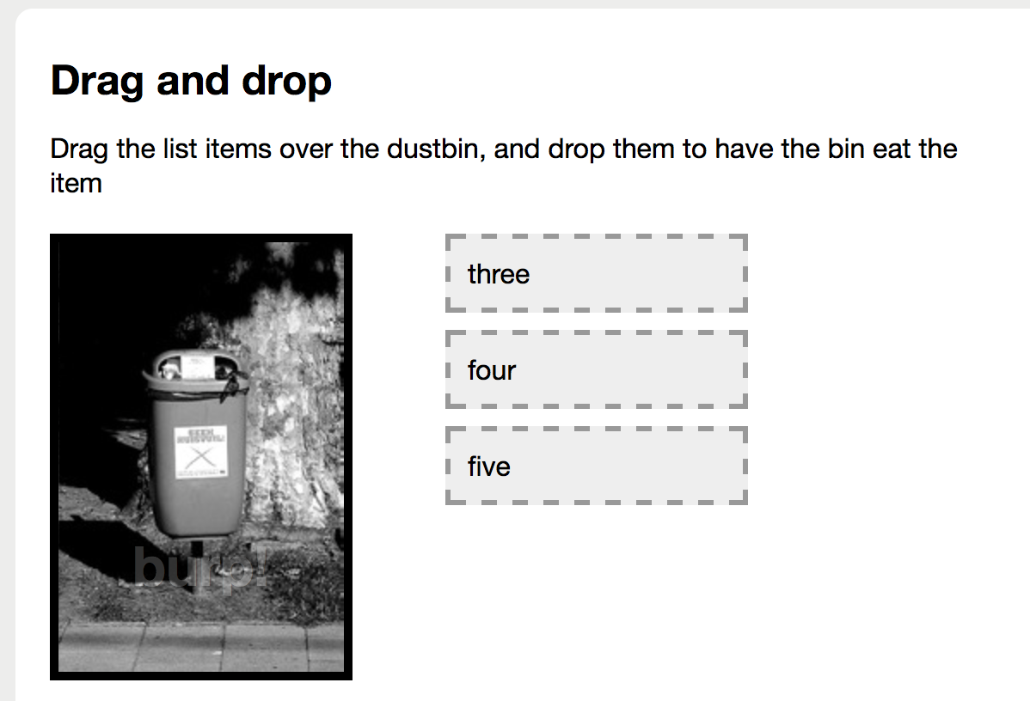
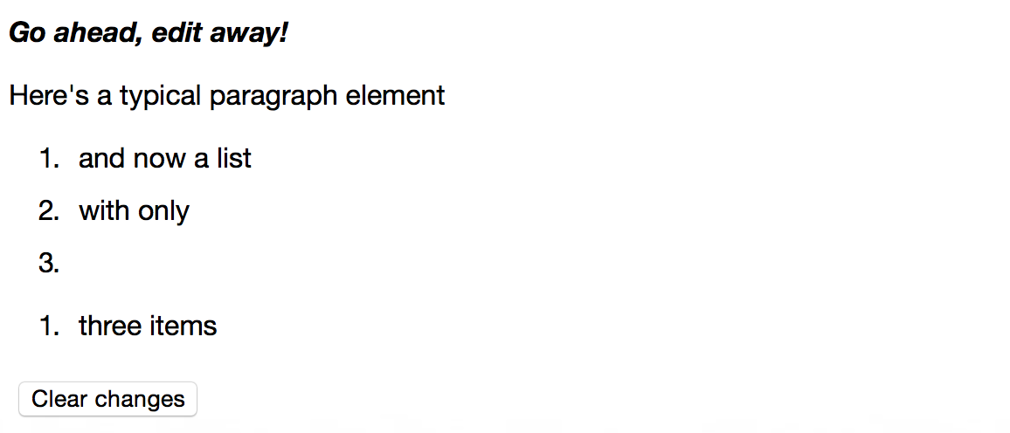
New DOM APIs (Cont.)
Drag and Drop / Document Editing
Notes:
contenteditable

Slide 16
New DOM APIs (Cont.)
Cross-domain messaging, server-sent events, WebSockets
Web Storage (max of 5Mb, key-value pairs)
localStorage, sessionStorage
Web Worker, Offline Web Application
Notes:
http://www.html5rocks.com/en/tutorials/workers/basics/

Slide 17
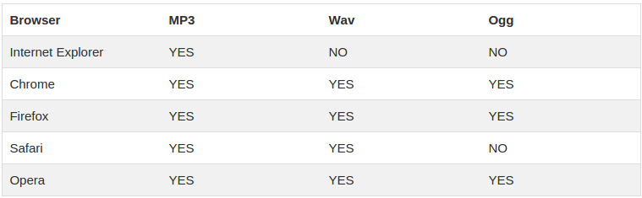
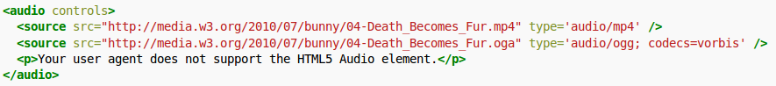
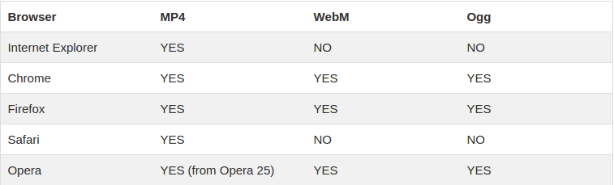
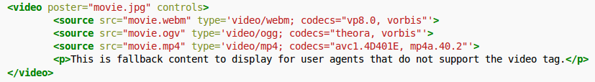
Audio and Video Formats
Audio
Video

Slide 18
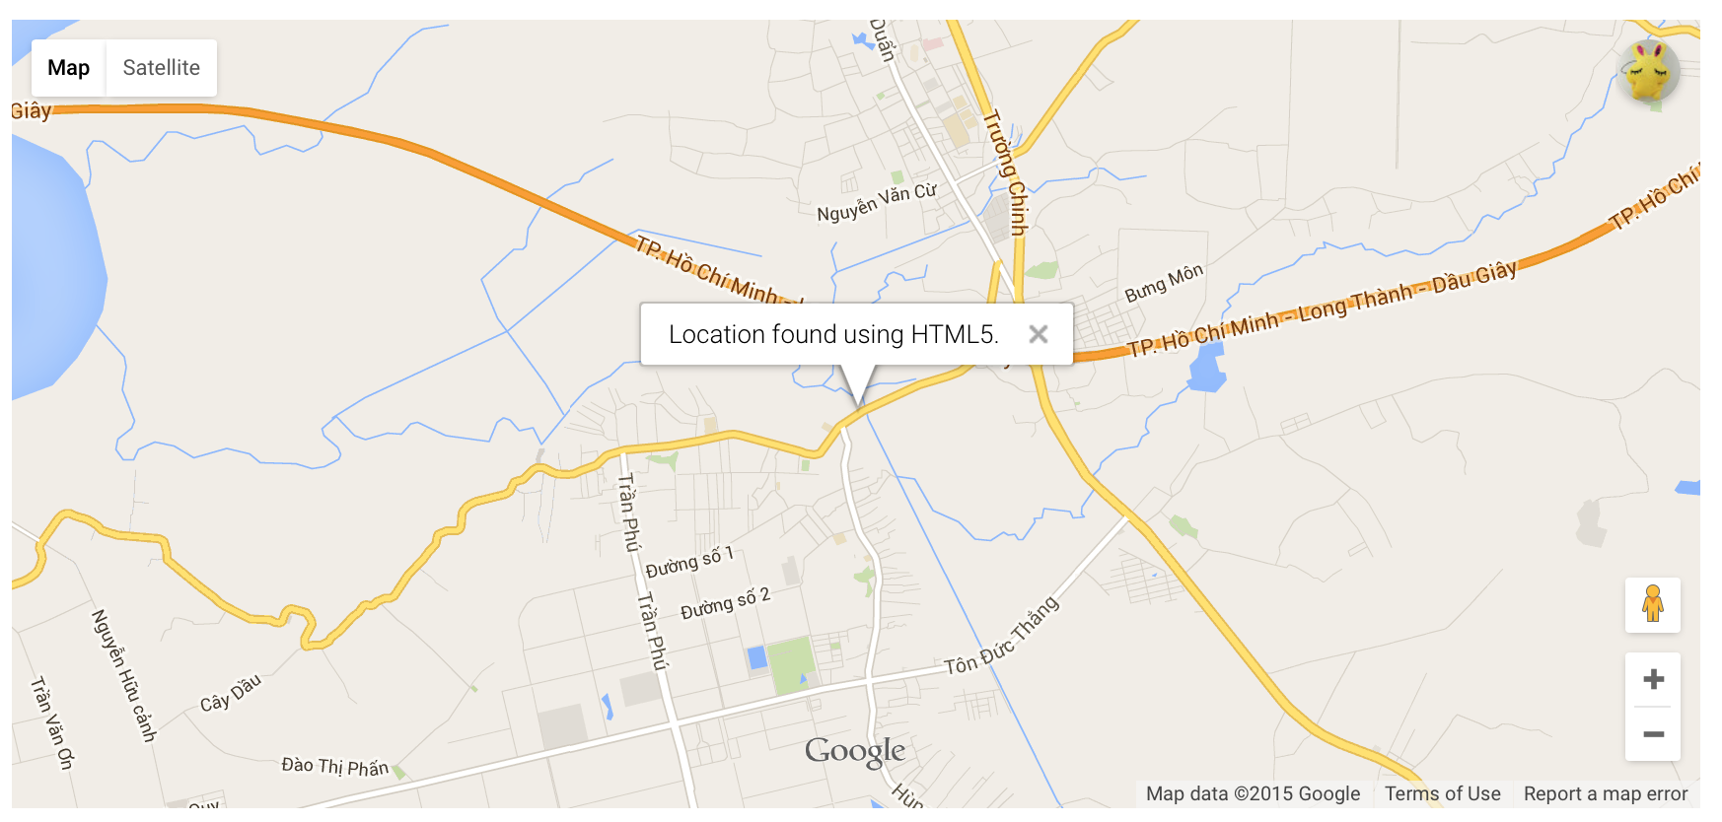
Additional APIs
Geolocation API
Indexed database (IndexedDB, WebSQL)
File, FileReader, FileWriter and File System APIs

Slide 19
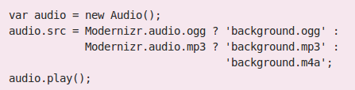
Browser Support
HTML5 support varies among browsers
HTML5 enabling script
Check for HTML5 support:
Manually
html5test.com
caniuse.com
w3schools.com
Dynamically
Modernizr

Slide 20
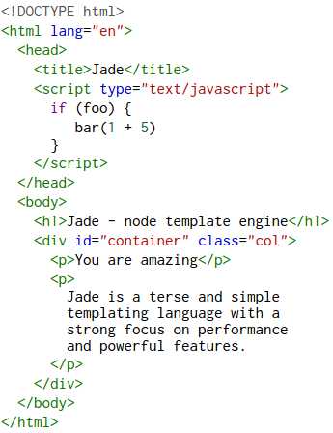
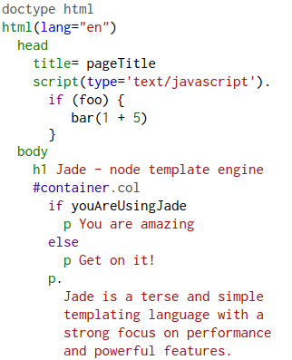
Template Engines
Jade
Haml
Notes:
rapid development, code consistency, standards compliance
http://www.quora.com/What-are-the-pros-and-cons-of-using-a-template-engine-like-Jade

Slide 21
Best Practices
Declare DOCTYPE
Always close your tags
Descriptive Meta Tags
Avoid Inline Styles
Have CSS Links in the <head> tag
Placing JS Files right before the closing <body>
Browser Support
Provide Fallbacks for Multimedia
Use CSS in place of JS
Text Alternatives (alt)
Use the new semantic tags instead of <div>
More best practices: https://github.com/hail2u/html-best-practices

Slide 22
Cascading Stylesheet

Slide 23
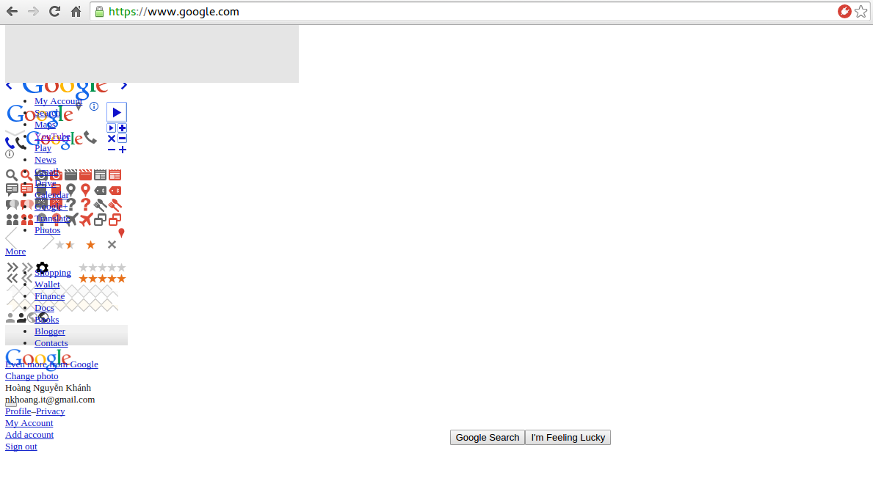
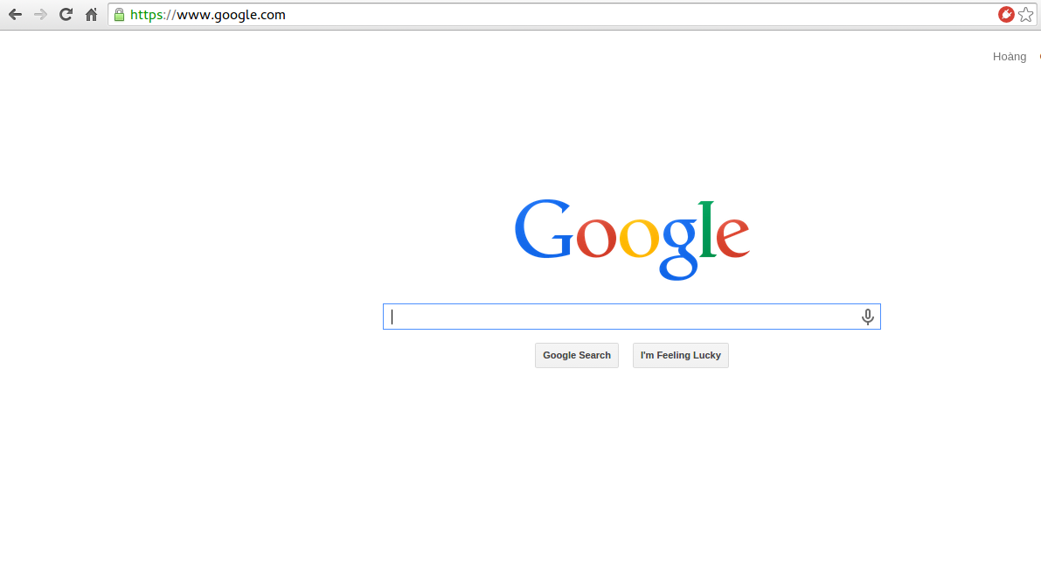
CSS

Slide 24
History of CSS
Major version: CSS 2.1
CSS3 is Modular
Selectors module: revision level 4
Fonts module: revision level 3
Flexbox: revision level 1

Slide 25
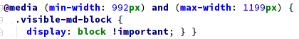
Media Queries
Syntax: logic media and (expression)
logic: not, only...
media: screen, print, all...
expression:
width and height
pixel ratio
orientation
aspect ratio

Slide 26
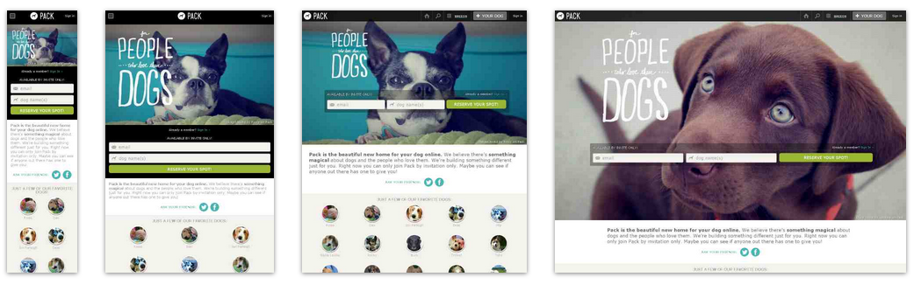
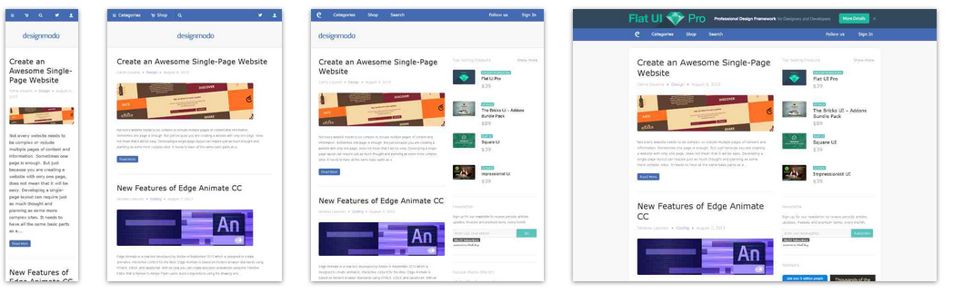
Example

Slide 27
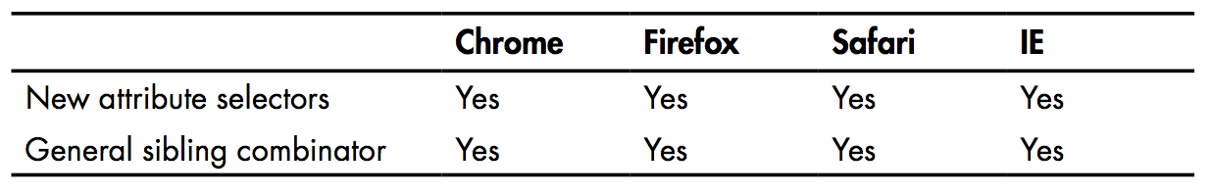
Selectors
Position and group selectors
Attribute selectors
New attribute selectors
E[attr^=’value’] {...}
E[attr$=’value’] {...}
E[attr*=’value’] {...} != E[attr~=’value’] {...}
Multiple attribute selector
Sibling selectors
E ~ F {...}
E + F {...}

Slide 28
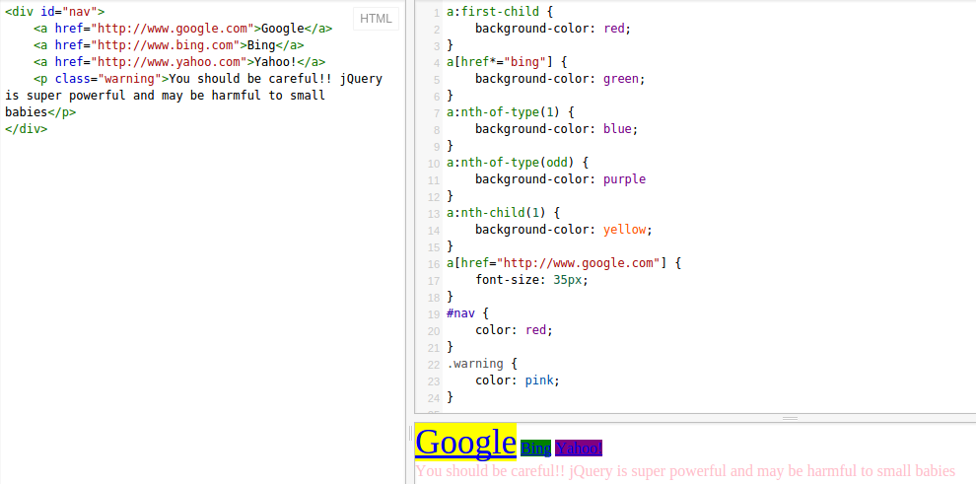
Example

Slide 29
pseudo-elements, pseudo-classes
pseudo-classes:
:hover, :visited, :active
:valid, :invalid, :required, :selected
Others: :target, :empty, :not, :root
pseudo-elements:
::selection, ::after, ::before

Slide 30
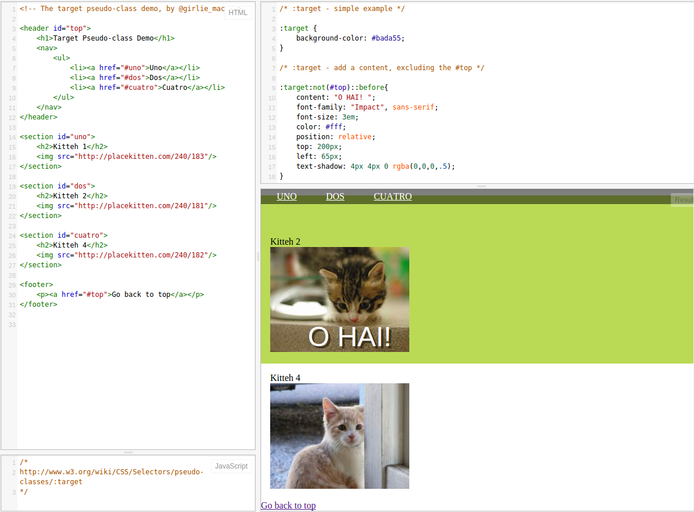
Example

Slide 31
Font
Using @font-face:
@font-face {
font-family: ‘CartoonisHand’;
src: url(‘CartoonistHand.woff’) format(‘woff’)
}
true vs artificial
Formats: .eot (ms), .woff (mozilla), .ttf, .svg
Generator:
http://fontsquirrel.com/fontface/generator
Font loading issue:
Flash of Unstyled Text (FoUT)
Web Font Loader

Slide 32
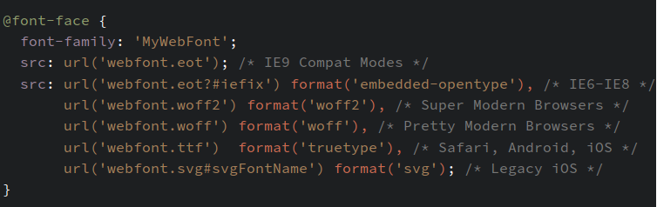
Using @font-face

Slide 33
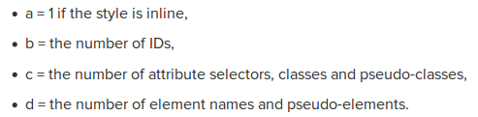
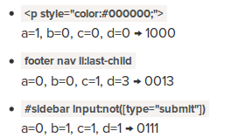
CSS Specificity and Inheritance
The “cascade” ties to 3 main concepts:
Importance
User agent declarations
User declarations
Author declarations
author !important declarations
User !important declarations
Inheritance
color, font-family, font-size, text-align...
Specificity

Slide 34
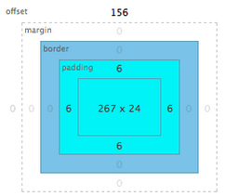
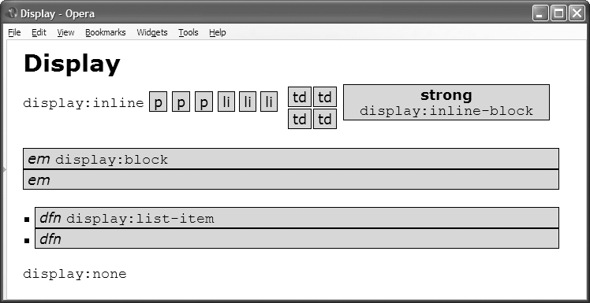
Boxing Models
The Box Model design pattern is built into CSS. This model defines the relationship between the following properties: display , width , height , padding , border , margin , background , overflow , and visibility .

Slide 35
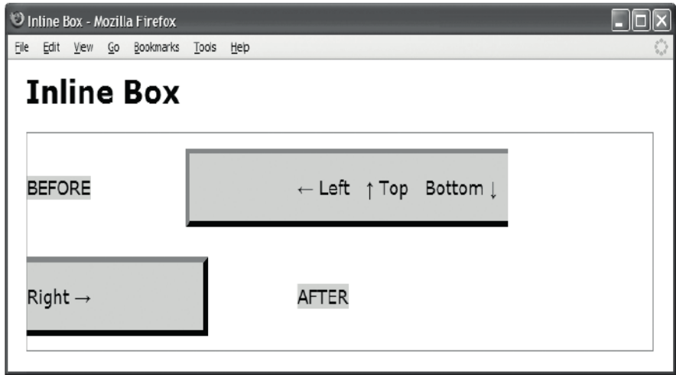
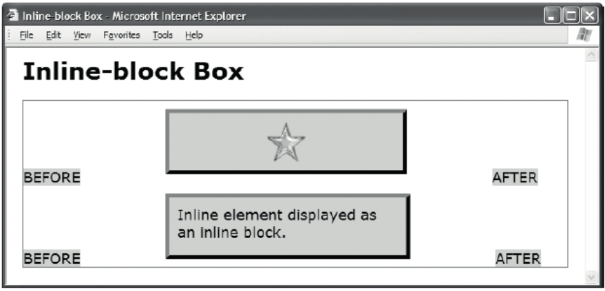
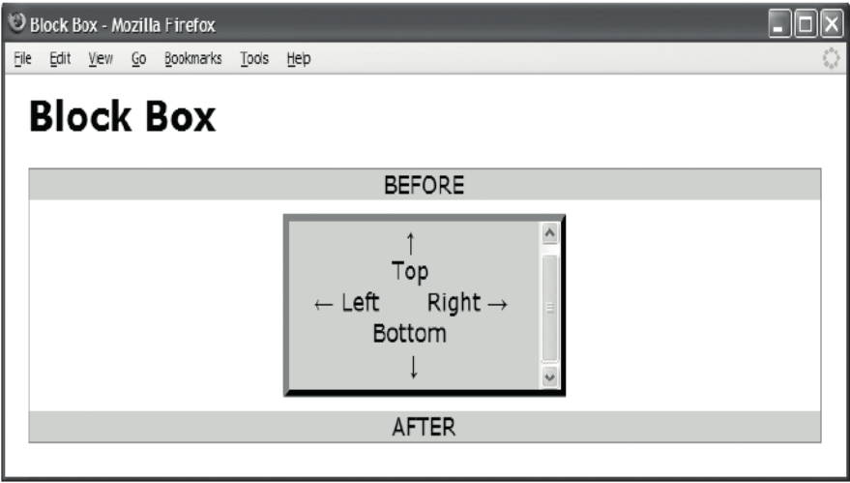
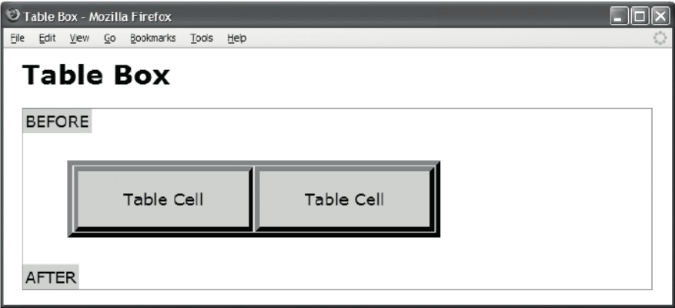
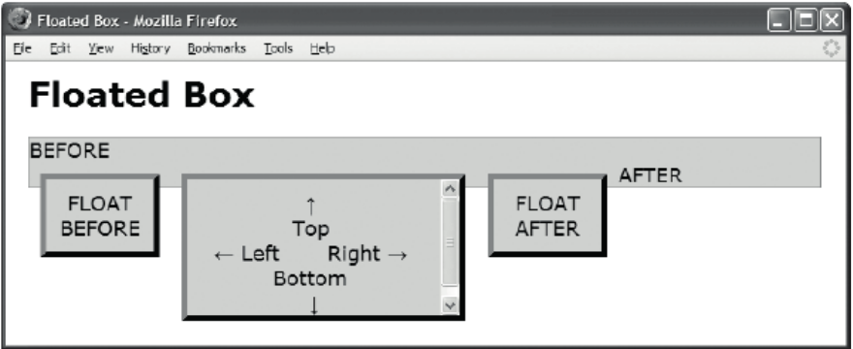
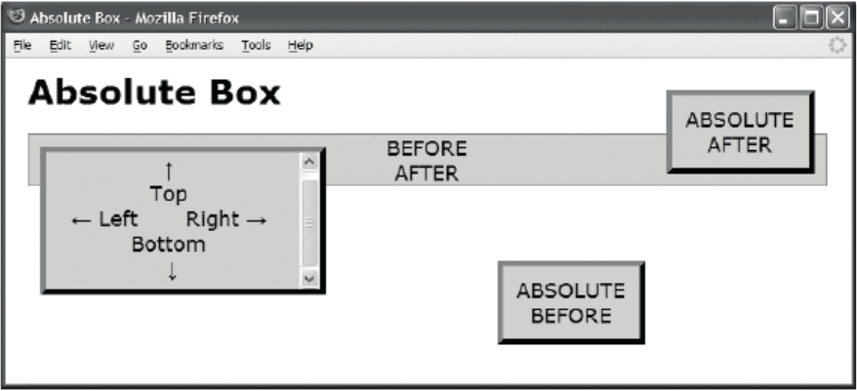
Boxing Models (cont.)

Slide 36
Stacking Context
A stacking context is rendered in layers from back to front as follows:
Background color, image, and borders of the stacking context element
Descendant positioned elements with a negative z-index
Descendant non-positioned block elements
Descendant non-positioned floats
Descendant non-positioned inline elements
Descendant positioned elements with z-index:auto and z-index:0
Descendant positioned elements with a positive z-index

Slide 37
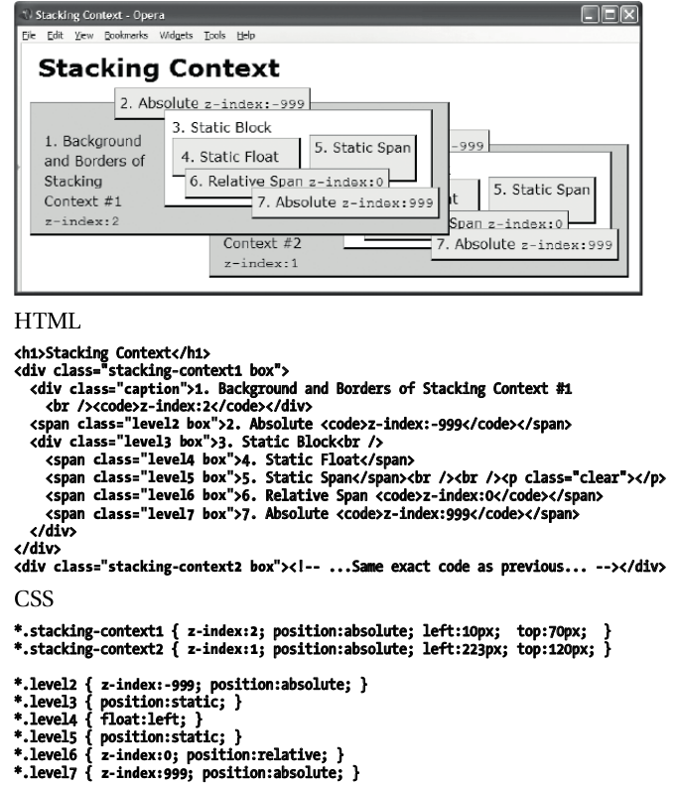
Stacking Context

Slide 38
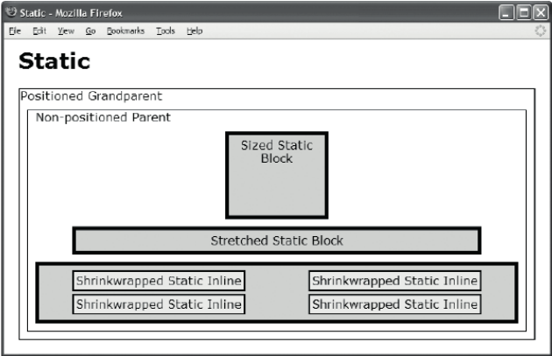
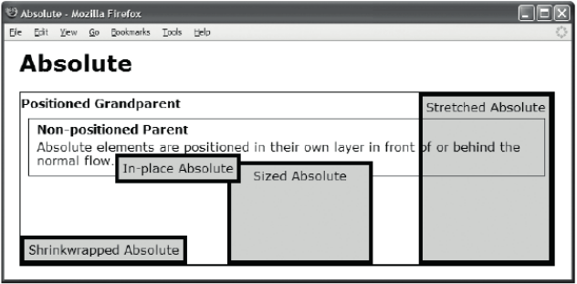
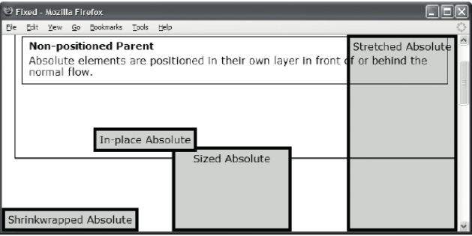
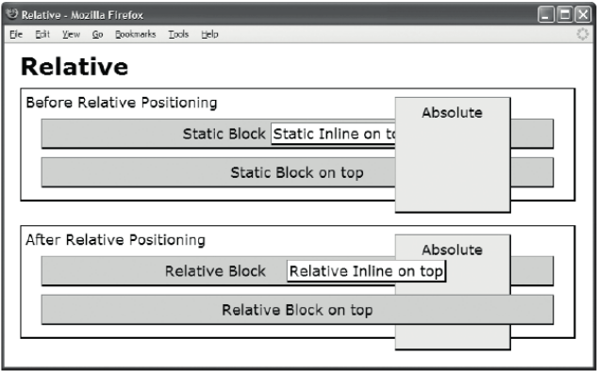
Positioning Models

Slide 39
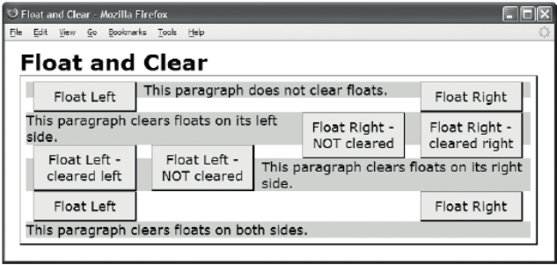
Positioning Models (cont.)

Slide 40


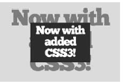
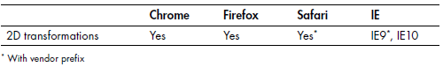
2D Transformation
rotate
translate
scale
skew
transform using matrix

Slide 41

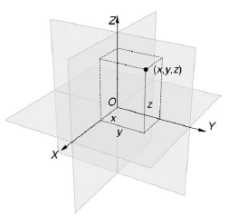

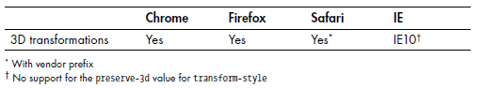
3D Transformations
rotate
transform-origin
perspective
scale
translate
Notes:
http://joecritchley.com/demos/time-machine/

Slide 42
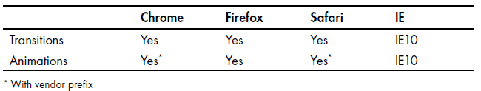
Transitions and Animations
transitions vs animations
Using @keyframes
Example: exampe 1, example 2
@keyframes example {
from {background-color: red;}
to {background-color: yellow;}
}
div {
width: 100px;
height: 100px;
background-color: red;
animation-name: example;
animation-duration: 4s;
}

Slide 43
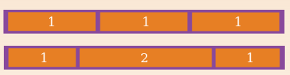

New in CSS3
flexbox
grid system (only IE)
calculated values

Slide 44
Responsive Design
Using Media Queries
Flexible Images
Using Fluid Layout
Principles When Working with a Fluid Design
Do not use fixed heights.
Do not necessitate horizontal scroll bars.
Think about how your images look at different sizes.
Think about wrapping content.
Think about spacing.
Think about the length of your lines of text.

Slide 45
Best Practices
Make it readable
Keep it consistent
Start with a framework
Use a Reset
Organize with a top-down structure
Use shorthands
Comment your CSS
Use CSS Compressors
Combine elements
More best practices:
30 CSS Best Practices
FrontEnd guidelines

Slide 46
Tools
Firebug
Chrome developer tools, IE Developer Tools
Autoprefixer
Compressor/Optimizer
CSSTidy
Minify
YUICompressor
csso

Slide 47


Preprocessors
Several reasons to use:
faster development
re-use code
easier to maintain
more organized
Few of them:
SASS
LESS

Slide 48
CSS Framework
Few of them: 960 grid system, Foundation, Bootstrap
GOOD
Learn CSS
Don’t need to write everything from scratch
Relieve cross-browser concerns.
Build good habits.
Encourage grid based design (readability, scanability, flexibity, expandability..)
Come with documentation.
BAD
Learn how to use it.
Change the way you write your HTML.
Can be bloaty.

Slide 49
CSS Framework
Few of them: 960 grid system, Foundation, Bootstrap
GOOD
Learn CSS
Don’t need to write everything from scratch
Relieve cross-browser concerns.
Build good habits.
Encourage grid based design (readability, scanability, flexibity, expandability..)
Come with documentation.
BAD
Learn how to use it.
Change the way you write your HTML.
Can be bloaty.

Slide 50
Assignment

Slide 51

Build a simple responsive website

Slide 52

Build a simple responsive website

Slide 53

Build a simple responsive website

Slide 54

Build a simple responsive website

Slide 55

Build a simple responsive website

Slide 56

Build a simple responsive website

